Slide 1
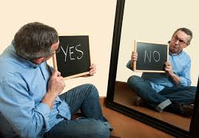
IMAGE MANAGEMENT: IMPRESSION & SELF-GROOMING

Slide 2
INTRODUCTION
Objective:
What is Image Management?
How impression effects our image?
Why we need to manage our image?
Why we fail to impress others?
How to overcome failure of rejection?
Motivation & Ethical Based Self-grooming
Tips and tricks on daily basis & at professional level.
Conclusion

Slide 3

IMAGE MANAGEMENT
Definition:
Personal Image Management is the self-presentation, self-promotion, and professional presence of your personality.
It consist of 2 basic elements:
Impression
Self-grooming

Slide 4
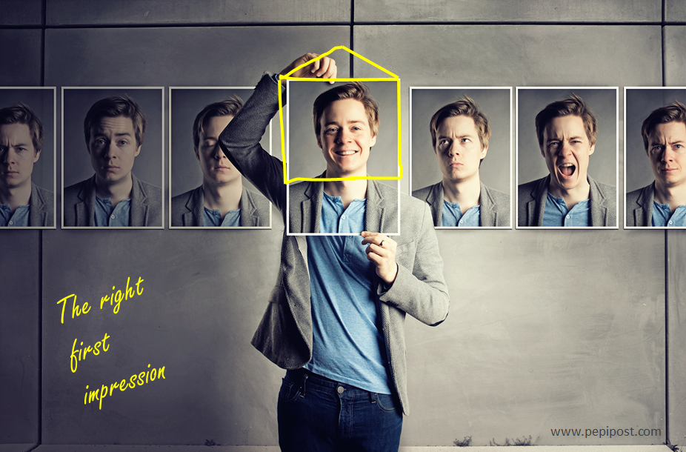
IMPRESSION

Slide 5
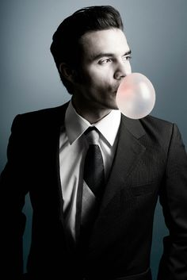

What is Impression ?
It is the overall effect of something e.g. on a person.
Look at these picture and tell what is their impression on you?

Slide 6
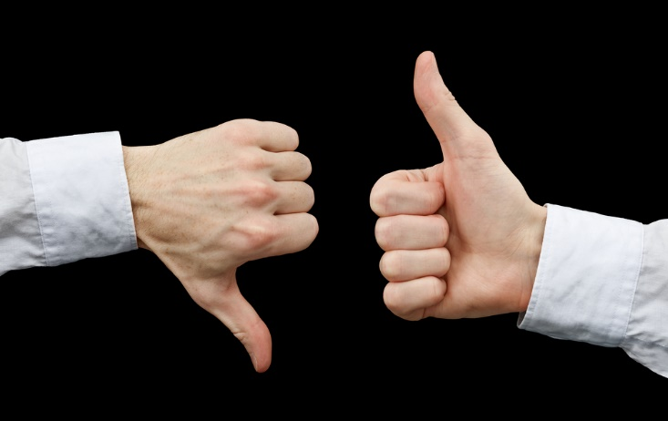
Why We Need To Manage Our Image?
Image management matters because people make assumptions and judgements based on very limited information.
You have just few seconds to make good first impression and it’s almost impossible to change it once it’s happened.
In this short time, the other person forms an opinion about you based on your appearance, your body language, and your mannerisms
So it’s worth giving each new encounter your best shot.

Slide 7

Why We Fail To Impress Others?
We fail to impress others because we have a
fear of rejection (shyness).
At the age of Confidence under construction, everyone had faced different past, different rejections.
This fear make us lose our confidences even when we grew up.
Recognize at what point people rejects you?

Slide 8

6 Ways To Overcome Failure Of Rejection
By working on following things:
Confidence
Appearance
Speaking Skills
Listening Skills
Being Genuine
Being Optimistic
If you follow these steps victory is all your way.

Slide 9
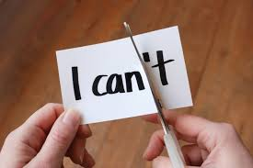
Confidence:
Being confident is the major part to impress someone.
We can win any fight by being confident on right path and by being calm.
How should we overcome this fear?
Engage more with people.
Try new things.
Talk more not less.
Practice displaying confident body language.
Be mindful.
Stop being shy.

Slide 10
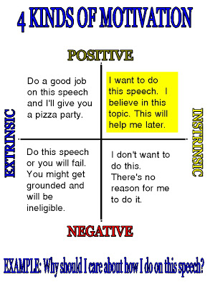
Confidence Building Through Motivation

Slide 11
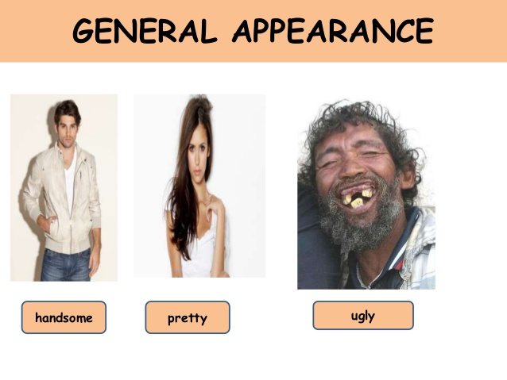
2. Appearance:
The second important factor to impress someone is our appearance.
How to overcome fear of poor Appearance?
Give a decent look
wear comfortable clothes
Work on your body-language
Know the occasion
Feel Confident

Slide 12
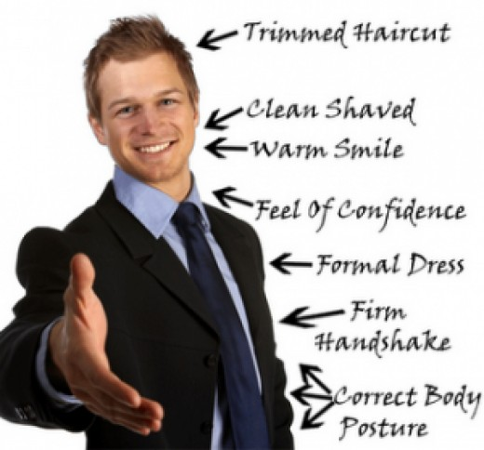
Formal Way To Appear In Interview

Slide 13
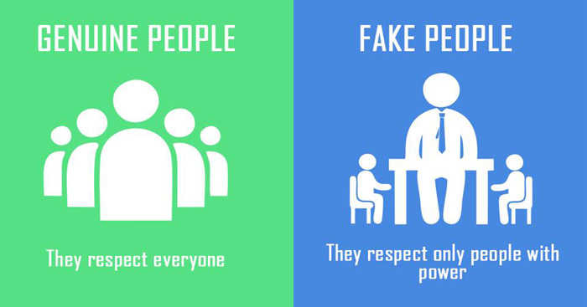
3. Being Genuine:
In our busy world, there's a lot of fakery, deception, and contrived perfection.
It is possible to be true to yourself and the people around you.
How to overcome fear of being genuine?
Be Real and never feel shy
Stop being attention seeker
Love what you are because people prefers a genuine man than the fake one

Slide 14
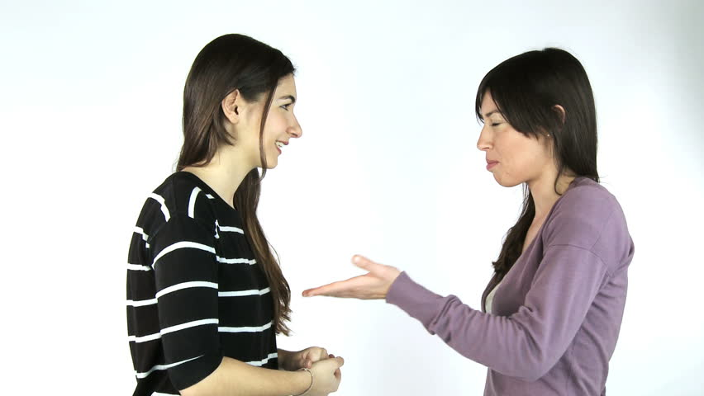
4. Speaking Skills
How to overcome fear of Speaking?
Know your material
Know your audience interest
Think once before speaking
Observe yourself in mirror
Be loud and clear
Practice, practice, practice!

Slide 15
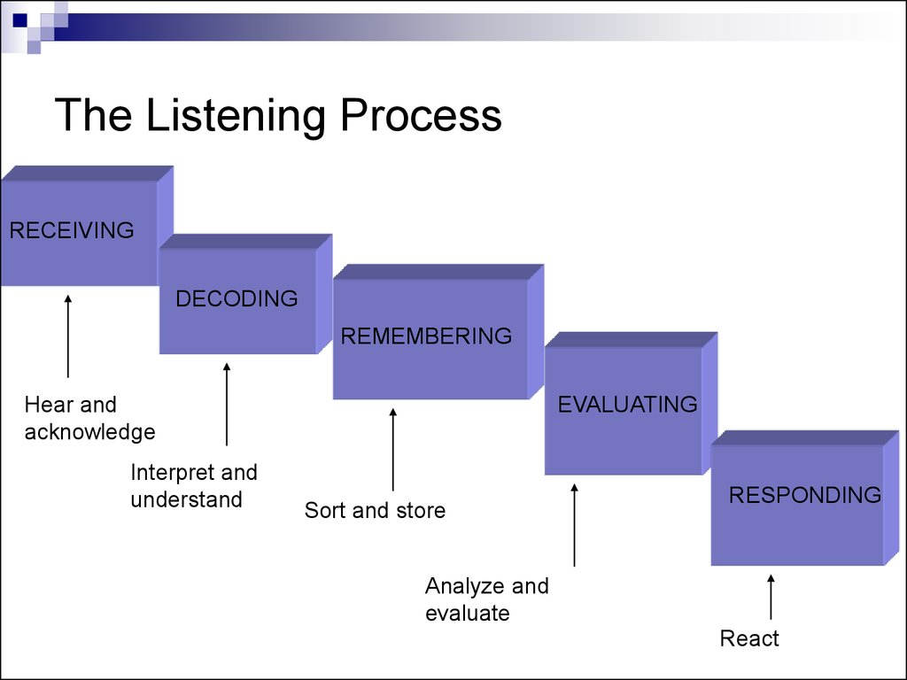
5.Listening Skills
Follow this process Sequentially:

Slide 16

How to overcome fear of Listening?
Follow listening steps in sequence not parallel.
Show interest to your speaker
Give your opinion after speaking
Work on your body language because that speaks when you are silent
Don’t make fun just listen carefully

Slide 17
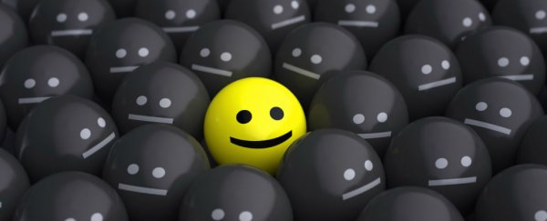
6. To Be Optimistic:
Change your perspectives
Think from the others end
How to overcome this fear?
Try to smile more often
If you can, avoid the company of negative
If you think positive, you live positive

Slide 18

SELF-GROOMING

Slide 19
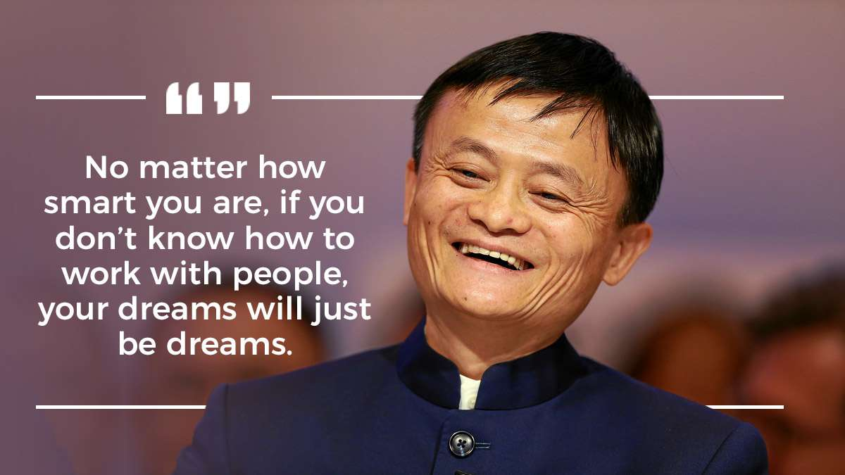
What is Self-Grooming?
Personal grooming (also called preening)
It is the art of grooming, and maintaining your personality.

Slide 20

Self-Grooming:
If you follow these steps you will groom yourself and the society.
Self-Motivation Grooming:
Set Your Internal Standard
See Problems As Opportunity
Take Blame And Credit
Ethical Grooming:
Respecting Others Opinion
Be Unbiased
Be Thankful For What You Have

Slide 21
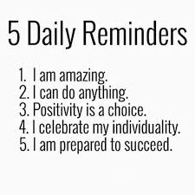
Motivational-Grooming:
Set Your Internal Standard:
Belief & you will do it

Slide 22
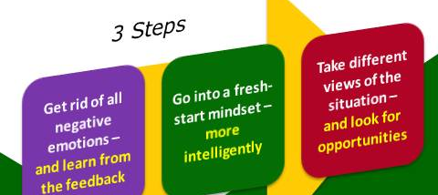
2. See Problems As Opportunity
The more we can test our limits and capabilities the more we will learn about ourselves.
New challenges are opportunities for us.
The downside is that when we take on new challenges we also have to face the possibility of failure.
Rather than seeing the opportunity in the situation we focus on what it will be like to fail.
Ignore Reactions, Focus on Improvements

Slide 23
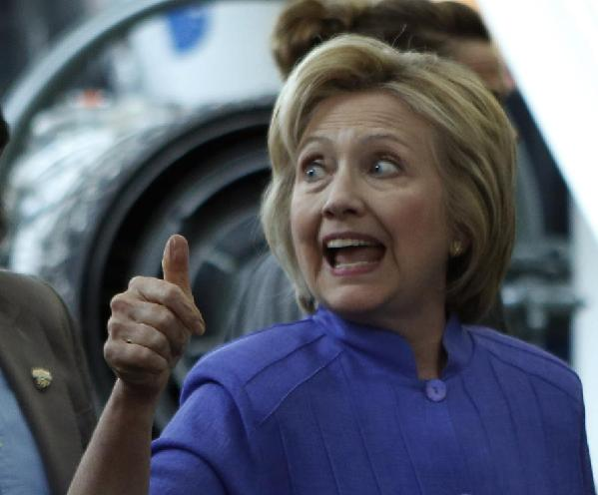
3. Take Blame And Credit
True leaders pull the thumb, before they point the finger
They turn each misstep into an opportunity to learn from the mistake instead of pointing figures.
They find a lesson while others only see a problem
If someone slipped up, they pick them up, they don't point the finger and pass the blame.

Slide 24
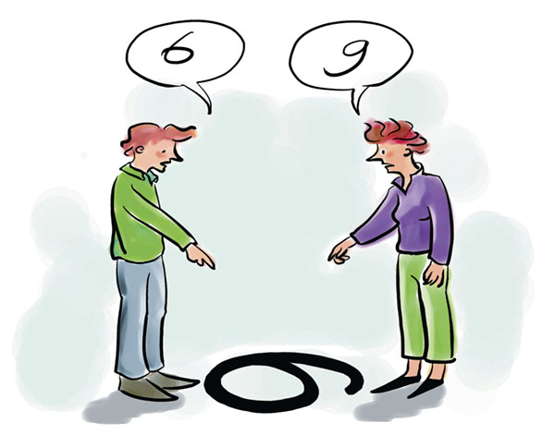
Ethical Grooming:
1. Respecting Others Opinion:
It can help us to understand that nobody is perfect and everybody thinks differently.
Respecting others opinions does not mean being untrue to your own.
Trying to understand others point of views is important because it help us to know more about life and people.
What is your opinion about this picture?

Slide 25
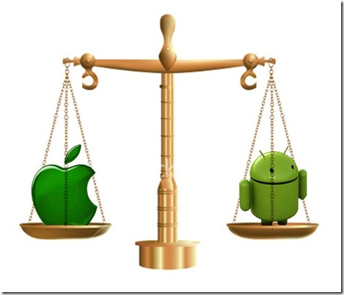
2. Be Unbiased:
How can you act Un-biased?
Follow these steps to keep yourself unbiased:
First and foremost, practice never making assumptions.
Cognitive Bias is unfair prejudice against anyone or anything for any reason.

Slide 26

3. Be Thankful For What You Have:
Be thankful for what you have, you'll end up having more.
If you concentrate on what you don't have, you will never, ever have enough.

Slide 27



Slide 28

Tips & Tricks (Daily Basis)
Want to impress other at first glance?
Give flooding smile
Keep sticky eyes
Limit fidgets
Big Baby Pivot
Use positive words
Be Confident but not over-confident

Slide 29

Tips & Tricks (Professional Level)
Be punctual.
Keep your work up to date.
Keep Full knowledge of your work.
Words and action should be similar.
Work differently.
Share attributes of success to others.
Give true appreciation to others.

Slide 30

CONCLUSION

Slide 31
Conclusion:
Image Management is Self-presentation to others.
It includes Self-Impression & Self-Grooming.
We need to impress others in order to develop self-power.
We are not born with fear, it is just our mindset.
Criticism is the name of opinions of different people at the same time.
To avoid shyness, we must face challenges.
We can overcome our failure of impressing others by working on our-selves such as our Confidence, body language, Communication skills and by being genuine
Self-Grooming is much based on Self-Motivation & Social Ethics

Slide 32
Continue….
Few Tips At First Impression: Flooding smile, being social, maintaining eye-contact, using positive words, limit-fidget.
Remember: know that not everyone will like you, and that’s okay.
Time will turn criticism into success only if you work on it.
“Don’t pretend to be what you are not, instead, pretend to be what you want to be, it is not pretence, it is a journey to self-realization.” ― Michael Bassey Johnson

Slide 33
References:
Books:
“Rich dad and poor dad” by Robert Kiyosaki.
“The Secret” by Rhonda Byrne.
YouTube Videos:
https://www.youtube.com/watch?v=yCyA13YRlU0
https://www.youtube.com/watch?v=TD884Dl-kLc
https://www.google.com.pk/search?q=activities+to+gain+confidence&rlz=1C1CHBF_enPK757PK757&oq=activities+to+gain+confidence&aqs=chrome..69i57.21435j0j1&sourceid=chrome&ie=UTF-8
https://www.google.com.pk/search?q=activities+to+gain+confidence&rlz=1C1CHBF_enPK757PK757&source=lnms&tbm=isch&sa=X&ved=0ahUKEwjk0e7EyIjeAhVaXCsKHeqOCNMQ_AUIDigB&biw=1422&bih=685&dpr=0.9#imgrc=w9IYrZsGxhqHYM

Slide 34
THANK YOU
ANY QUERY ?

